Slide 1

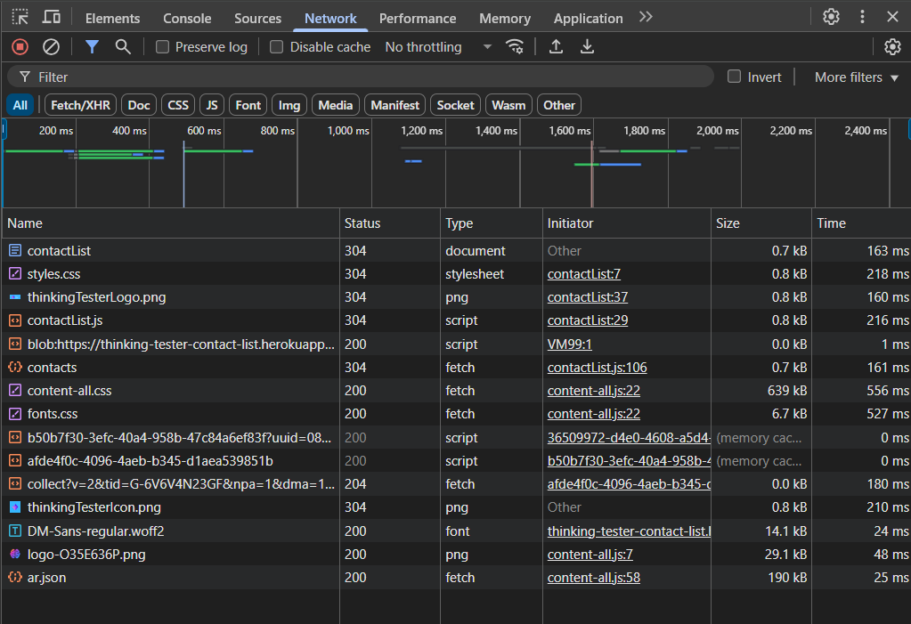
API TESTING
Prepared by Nagham,Hala,Foqaha,Badawi,Ehab

Slide 2

Introduction
Simulated real-world QA project using Scrum methodology.
5-day sprint with API testing on Contact List App.
Team worked on [Users or Contacts] APIs.
Tools used: Postman, Trello, Excel.

Slide 3

Objective
Understand and test REST APIs through UI mapping.
Design positive and negative test cases.
Automate API assertions in Postman.
Track test execution and bugs.
Present results with test reports and metrics.

Slide 4

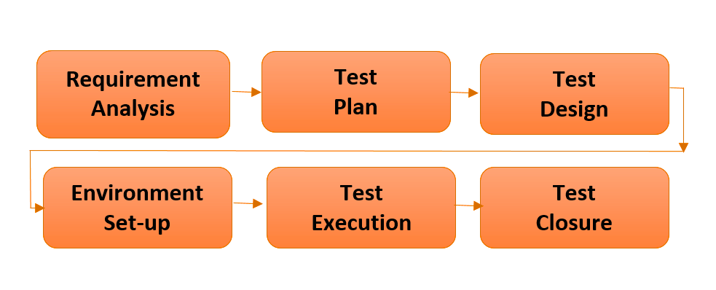
STLC

Slide 5

Requirement
Analysis
Studied Contact List API documentation.
Understood endpoints and how they're triggered from UI.
Identified required fields, methods, and error responses.
UI exploration helped map user actions to API calls.

Slide 6
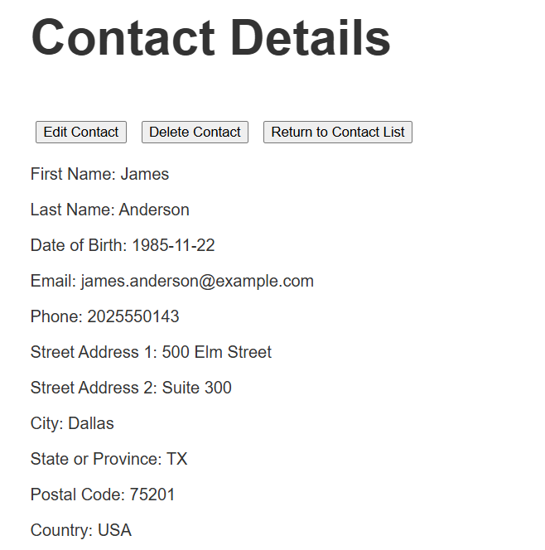
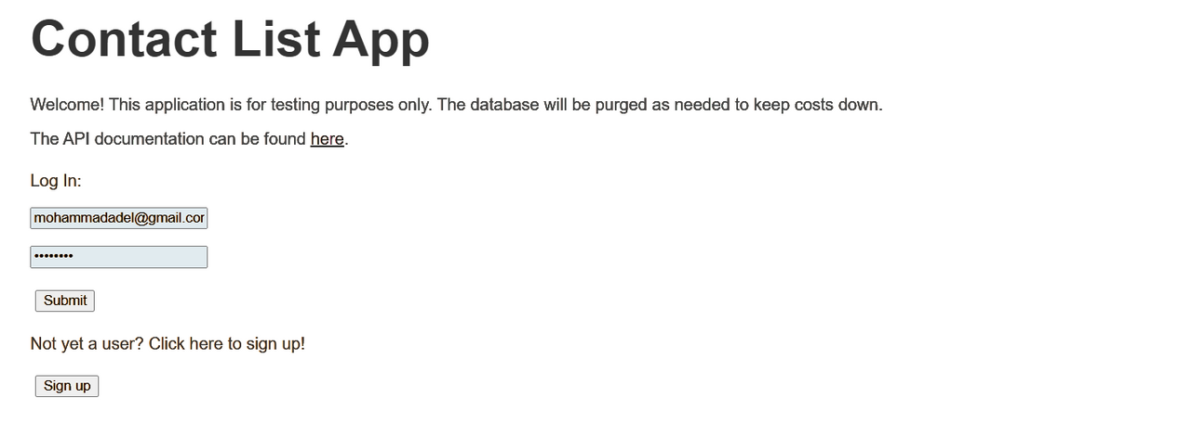
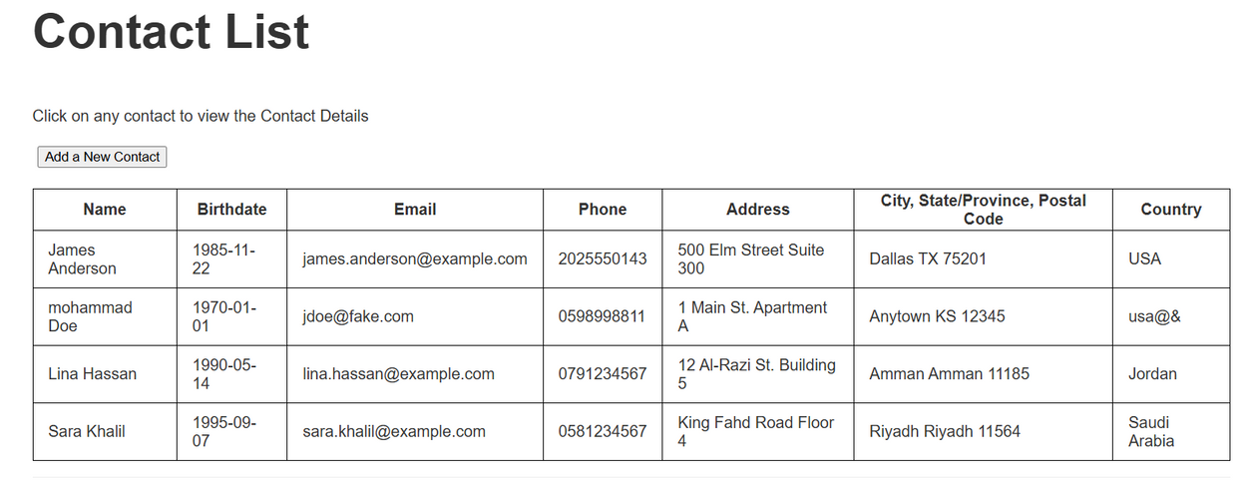
UI
Mapping

Slide 7
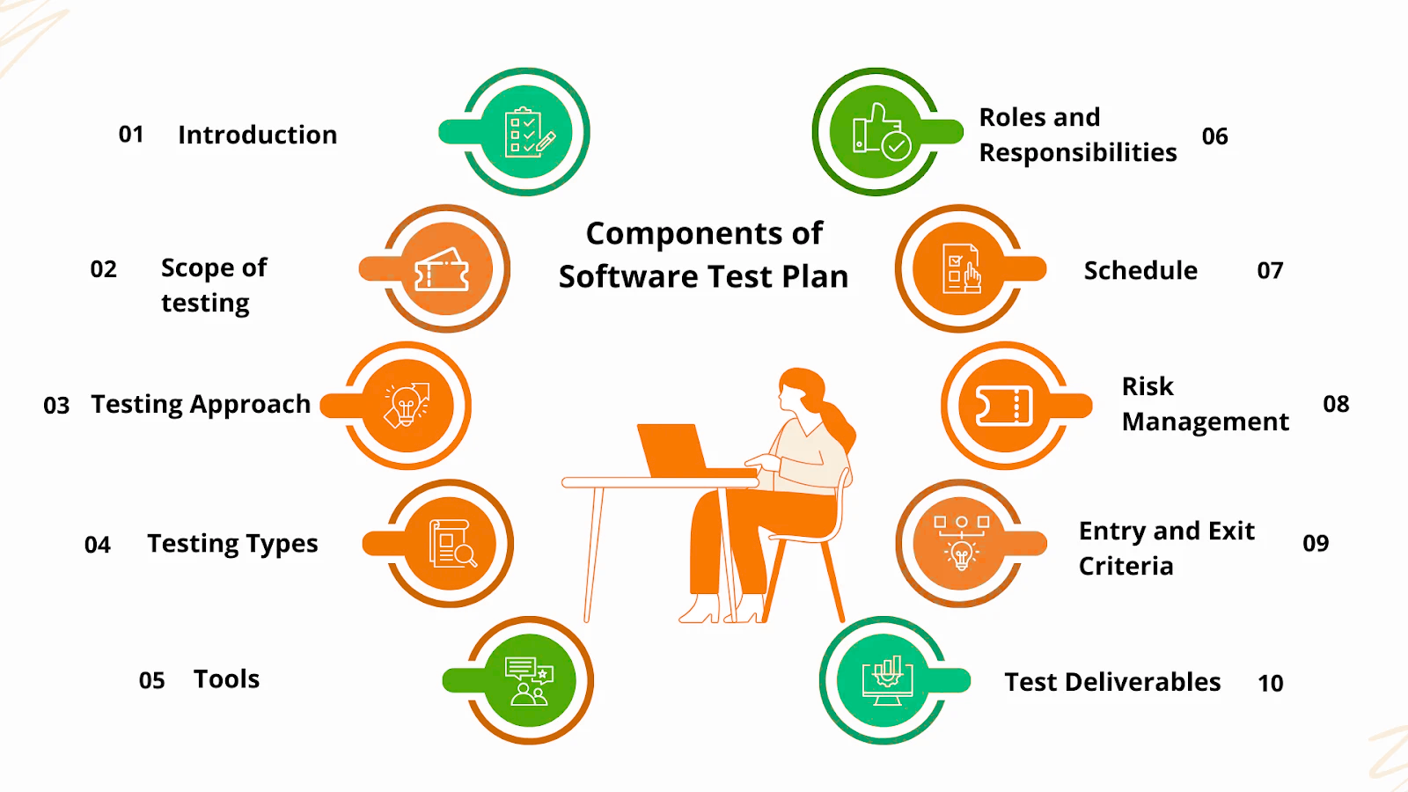
Test
Plan

Slide 8

RTM
Add New Contact | Add User
Get All Contacts | Get User Profild
Get Contact by ID | Update User
Update Contact Partially | Log Out User
Update Contact Fully | Log In User
Delete Contact | Delete User
To map each requirement to the test cases designed
and executed, ensuring complete test coverage.

Slide 9

Test
Case Design
Admin
Employee
USERS
CONTACTS
The Test Design Covers All the required Features For Both Module

Slide 10
Test
Case Design for Users
R1 -
(POST) Add User
R2-
(GET) Get User Profile
R3 -
(PATCH) Update User
R4 -
(POST ) Log Out User
R5 -
(POST ) Log In User
R6 -
(DELETE) Delete User

Slide 11
Test
Case Design for Contact
R1 -
(POST ) Add Contact
R2 -
(GET) Get Contact List
R3 -
(GET) Get Contact
R4 -
(PUT) Update Contact
R5 -
(PATCH) Update Contact
R6-
(DELETE) Delete Contact

Slide 12

Test Execution
Admin
Employee
USERS
CONTACTS
158 Tc’s
146 Tc’s
55 TCs
63 TCs
304Tc’s
118 TCs

Slide 13
BUGS
USERS
CONTACTS
11 Bugs
8 Bugs
19 Bug

Slide 14
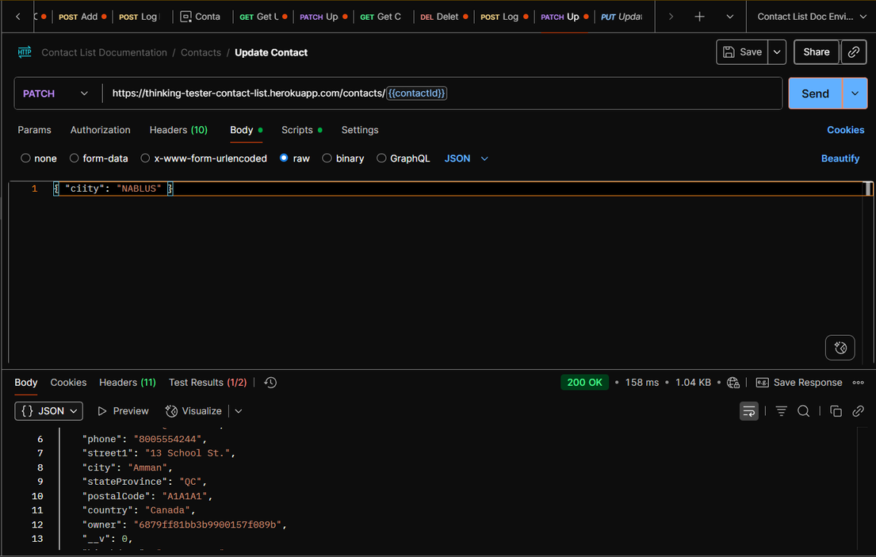
Selected
Bugs
Bug #1 . When sending a PATCH request with wrong field name ('citty'), the API returns 200 OK but ignores the update. It should return 400 Bad Request.

Slide 15
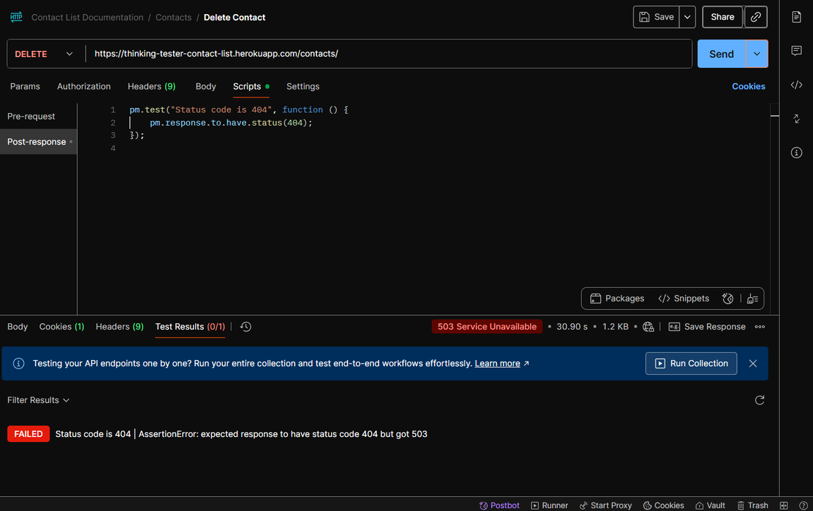
Selected
Bugs
Bug #2 . When attempting to update a contact using a PATCH request without specifying a contact ID in the URL, the API returns a 503 Service Unavailable status instead of the expected 404 Not Found.

Slide 16
Blocks
B#1. Additional users could not be added to the Postman workspace because the free plan allows only 3 users. To add more members, a paid plan is required.
B#2. Working on one shared Excel file caused issues — changes didn’t sync properly, and sometimes edits were lost or overwritten.
B#3. One team member from Gaza often lost internet connection, which affected team coordination and task updates.

Slide 17
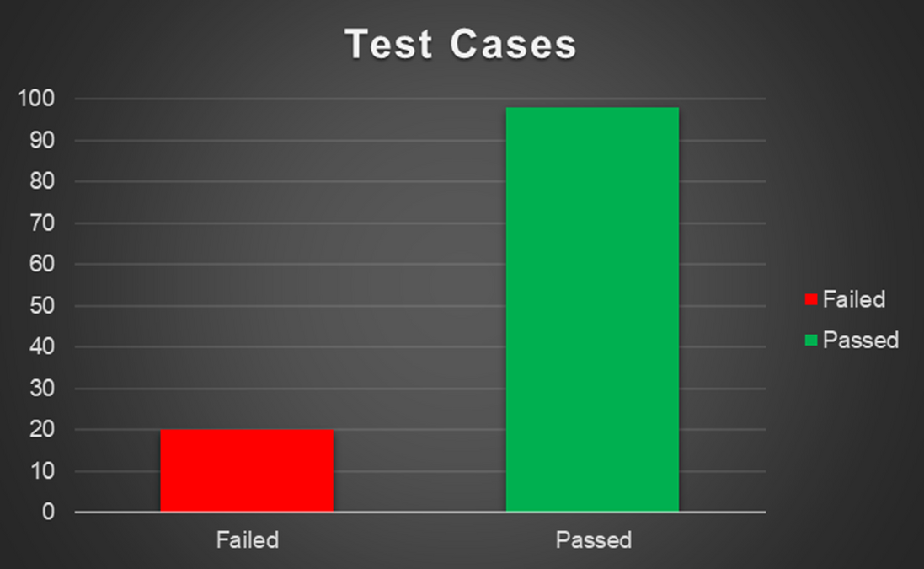
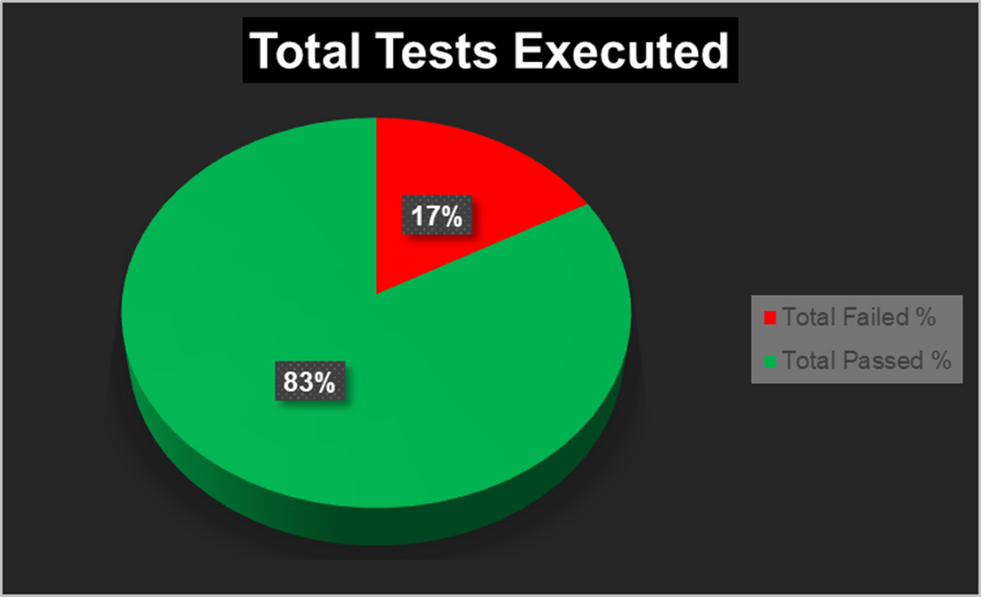
Test
Summary

Slide 18
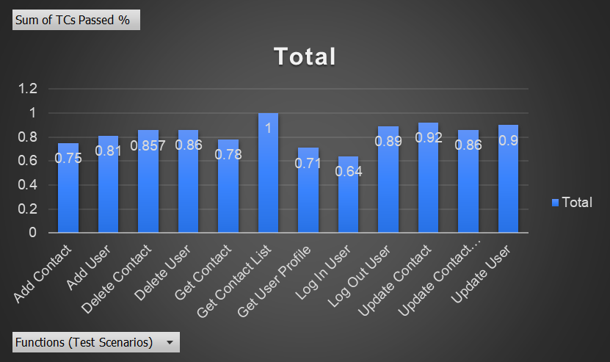
Test Cases
Passed Percentage

Slide 19
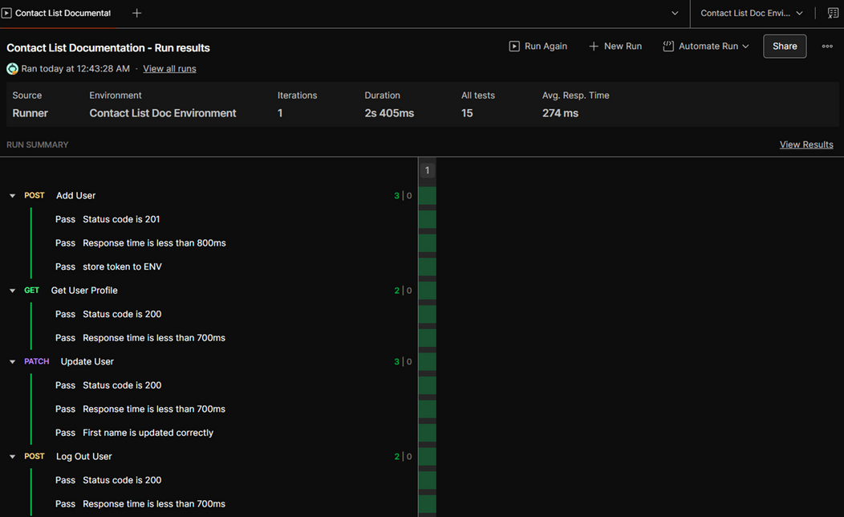
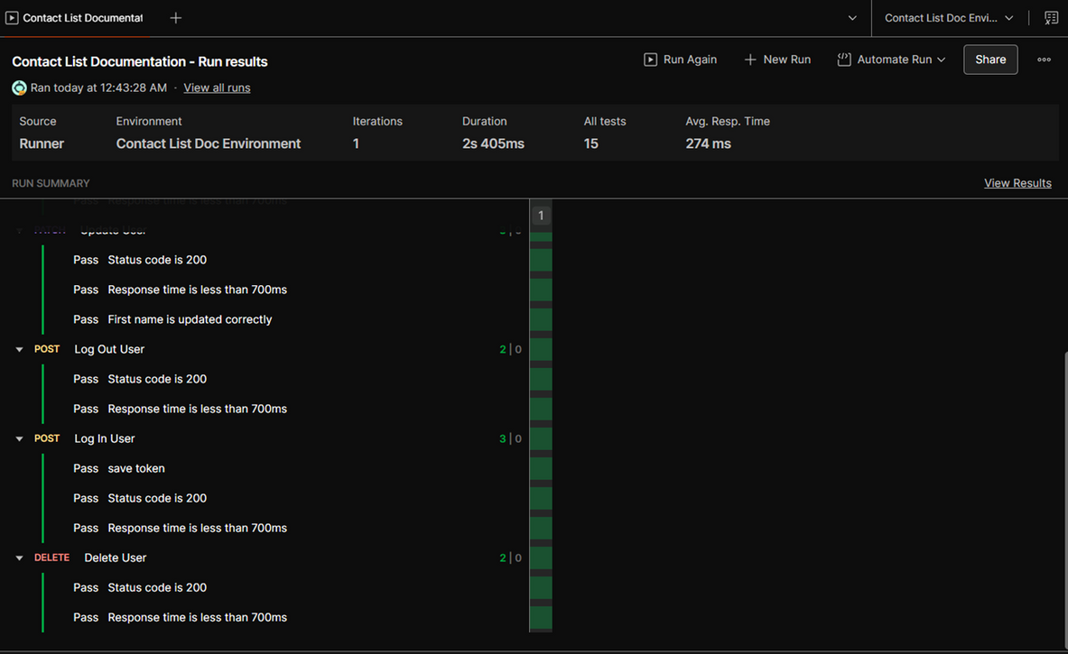
Run Collection (USERS)

Slide 20
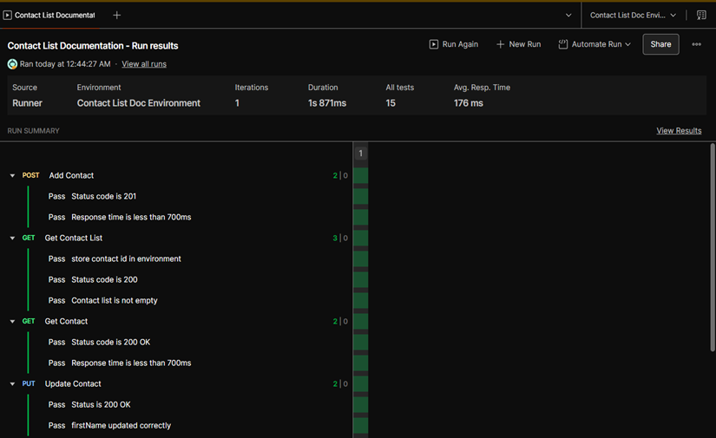
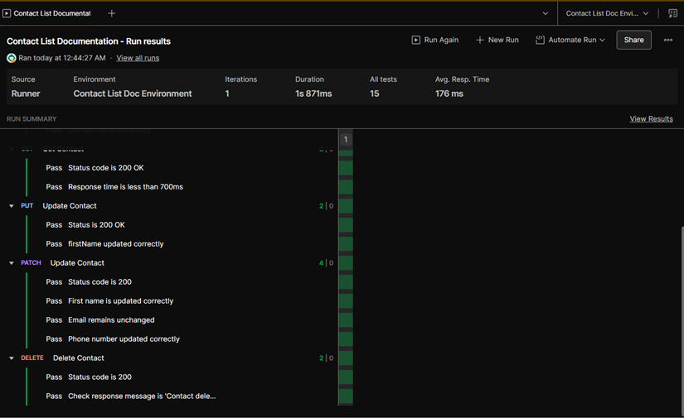
Run Collection (CONTACTS)

Slide 21
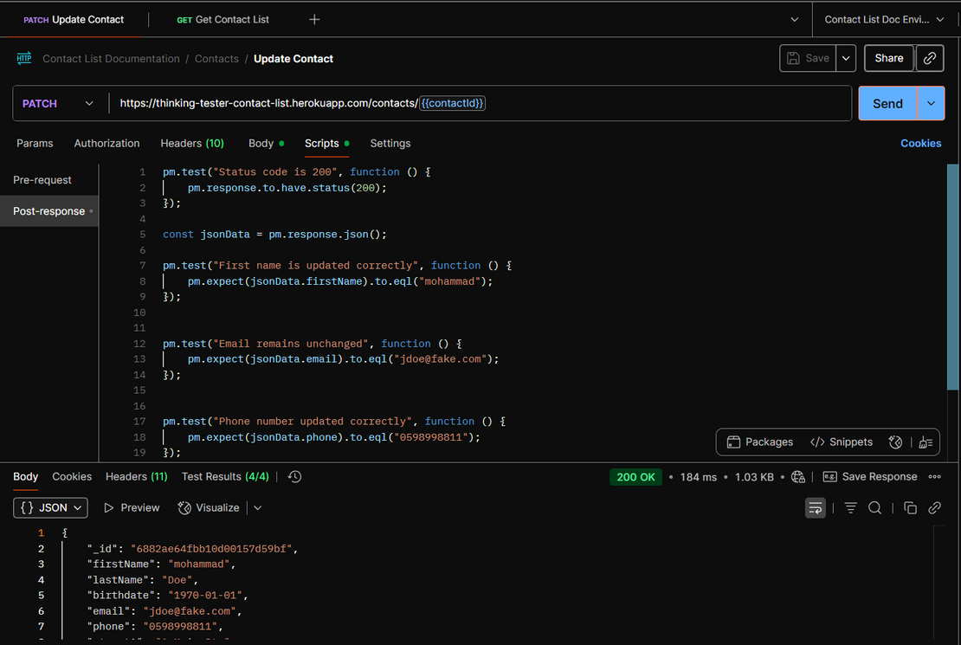
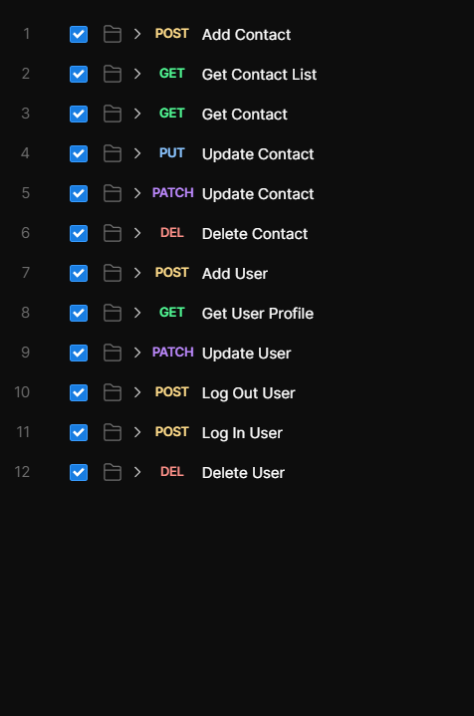
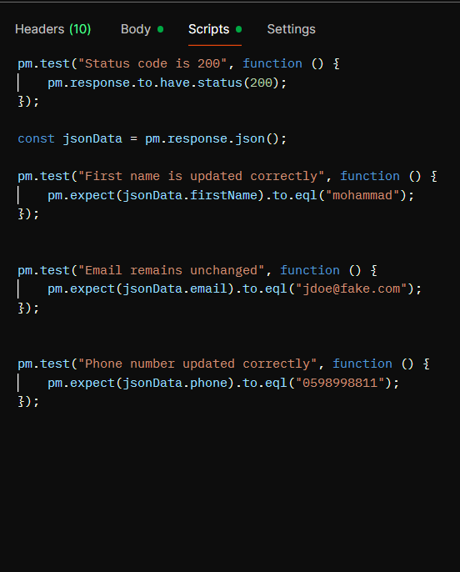
Thank you!

